Slide 1

Meetings 1-12
Fostering and Adopting
the Child Who Has Been Sexually Abused
sponsored by the
New York State
Office of Children and Family Services
through a training and
administrative services agreement with the
Research Foundation for SUNY
SUNY Buffalo State
Center for Development of Human Services

Slide 2
Meeting 1
Understanding Child
Sexual Abuse
© 2014 New York State Office of Children and Family Services.

Slide 3
Emotions
Think of (1) word that describes the emotion
you feel about being in
this training right now.
Write that emotion word
in bold letters on the
inside of your name tent.

Slide 4
Introductions
Interview each other and
find out:
NAME
Foster care experience
What that word means
to you

Slide 5
Purpose of Program
To help experienced foster/adoptive parents develop skills for building agency teamwork and birth family partnerships in
order to meet the needs
of children who have been sexually abused.

Slide 6
Five Introductory Meetings (1 of 2)
Meeting 1:
Understanding Child Sexual Abuse
Identifying Possible Signs of Sexual
Abuse in Children’s Behavior
The Effects of Sexual Abuse
on Children’s Needs
Meeting 2:
Meeting 3:

Slide 7
Five Introductory Meetings (2 of 2)
Meeting 4:
Handling the Double Trauma
of Sexual Abuse and Placement
Managing Behaviors to Meet
the Needs of Children Who Have
Been Sexually Abused
Meeting 5:

Slide 8
Seven Advanced Skills Meetings (1 of 3)
Meeting 6:
Managing the Impact on the
Adoptive/Foster Family of a Child Who
Has Been Sexually Abused Abuse
Managing the Emotional Impact on the Adoptive/Foster Family of a Child Who
Has Been Sexually Abused
Meeting 7:

Slide 9
Seven Advanced Skills Meetings (2 of 3)
Meeting 8:
Responding to Disclosures
of Prior Sexual Abuse
Preventing Further Sexual Abuse
Handling False Allegations of Sexual Abuse
Meeting 9:
Meeting 10:

Slide 10
Seven Advanced Skills Meetings (3 of 3)
Meeting 11:
Teamwork With Mental Health, Legal
and Social Service Providers for the
Child Who Has Been Sexually Abused
Partnership With Birth Families of Children Who Have Been Sexually Abused
Meeting 12:

Slide 11

Film
Breaking Silence
by Theresa Tollini
Future Educational Films, Inc
232 E. Blithdale Avenue
Mill Valley, CA 94941
(415) 380-8027
Fax: (415) 380-8028

Slide 12
Film
Adult Victims of Child Sexual Abuse:
Nita; Barbara; Janet; Judy; Robin;
Eugene; David; Michelle
Mother Who Did Not Abuse nor Protect:
Laverne
Father Who Sexually Abused:
David

Slide 13
Film Tasks
Emotions & Needs:
– Adult Child
– Person Who Sexually Abused
– Non-Abusing Spouse
Consider Immediate
and Long–Term Effects
of Child Sexual Abuse

Slide 14
Small-Group Tasks (1 of 2)
Group 1:
I.D. Emotions & Needs of Children in Film. Also I.D. Immediate & Long-Term Effects of Child Sexual Abuse
© 2014 New York State Office of Children and Family Services.

Slide 15
Small-Group Tasks (2 of 2)
Group 2:
I.D. Emotions & Needs of David (Sexually abused his daughter)
Group 3:
I.D. Emotions & Needs of Laverne (Did not abuse nor protect)

Slide 16
Meeting 2
Identifying Possible Signs
of Sexual Abuse in
Children’s Behavior
© 2014 New York State Office of Children and Family Services.

Slide 17
Expected Sexual Behaviors
Birth to 2
2 to 6
6 to 12
12 to Adulthood
© 2014 New York State Office of Children and Family Services.

Slide 18
Meeting 3
The Effects of Sexual Abuse on Children’s Needs
© 2014 New York State Office of Children and Family Services.

Slide 19
Warm-Up
Think of an animal you would like to be.
Write it on a piece of
note paper.

Slide 20
Five Human Needs
1. Survival
2. Safety
3. Love & Belonging
4. Self-Esteem
5. Making Dreams
Come True

Slide 21

Cycle of Need
Need
Relaxation
Expression
(Behavior)
Need is Met

Slide 22
Cycle of Unmet Need
Need
Anxious
Angry
Fearful
MISTRUST
Expression
(Cry)
Need is
Not Met

Slide 23
Cycle of Need in Child Sexual Abuse
Need
Afraid
Confused
Angry
Expression
Need is Met
by Sexual
Abuse

Slide 24
Effects of Sexual Abuse
GUILT
Fear & Betrayal
Low Self-Esteem & Poor
Social Skills
Being Shocked by Sex
Acting Older (pseudomaturity)

Slide 25
Fears of Children Who Have
Been Sexually Abused
Separation & Abandonment
Physical Damage or Injury
Retaliation
Betrayal

Slide 26
Meeting 3, Handout 3
List Cathy’s:
Emotions
Behaviors
Underlying Needs
Strengths
(10 Minutes)

Slide 27
Meeting 4
Handling the Double
Trauma of Sexual Abuse
and Placement
© 2014 New York State Office of Children and Family Services.

Slide 28
Warm-Up
Think of a secret about yourself which your would want no person in this
room to learn about.
Write that secret on your
card and seal in an envelope with your name on it.

Slide 29
11 Placement Issues (1 of 2)
1. Abandonment
2. Rejection
3. Shame
4. Guilt
5. Anger
6. Denial

Slide 30
11 Placement Issues (2 of 2)
7. Fear
8. Thoughts of Death
9. Helplessness
10. Repeating Familiar Pain
11. Expecting Punishment

Slide 31
Instructions
For your placement issue, identify the child’s needs
and what you can say or
do to meet these needs.
Select a reporter/recorder.
(12 Minutes)

Slide 32
Three Phases of
Adjustment to Placement
1. Early
2. Acute
3. Integration
© 2014 New York State Office of Children and Family Services.

Slide 33
Meeting 5
Managing Behaviors to Meet the Needs of Children Who Have Been Sexually Abused
© 2014 New York State Office of Children and Family Services.

Slide 34
The Five C’s
1. Color
2. Cuisine
3. Car
4. Candy
5. Closet Desire

Slide 35
Cycle of Need
Need
Relaxation
Expression
(Behavior)
Need is Met

Slide 36
Guidelines for Meeting the Needs of Children Who Have Been Sexually Abused (1 of 4)
1. Offer support to the child in
a clear but unobtrusive way.
2. Develop a daily routine and
stick to it as much as possible.
3. Provide the child with as much privacy as possible.
4. Offer choices to the child
whenever possible.

Slide 37
Guidelines for Meeting the Needs of Children Who Have Been Sexually Abused (2 of 4)
5. Help the child label his or her emotions.
6. Help the child express his or his feelings directly and in positive, healthy ways.
7. Help the child state his or her needs clearly and directly.
8. Catch the child being good.

Slide 38
Guidelines for Meeting the Needs of Children Who Have Been Sexually Abused (3 of 4)
9. Provide physical outlets for
the child.
10. Encourage creative expression.
11. Help the child to be a child and
to experience fun.
12. Provide the child with
information so the child knows what is happening and when.

Slide 39
Guidelines for Meeting the Needs of Children Who Have Been Sexually Abused (4 of 4)
Be aware of the increased risk
to the child of further abuse
and take the necessary steps to prevent it.
14. Do not permit yourself to be
talked into taking another child into your home if you are having difficulty managing the children
for whom you are currently providing care.

Slide 40
Most Frequent & Bothersome Behaviors
Seductive
Angry, Aggressive
Alcohol & Other Drug Abuse
Suicide Attempts
Running Away

Slide 41
Four Steps For Involving Children in Managing Their Behavior (1 of 4)
1. Begin with positives
such as:
“We care about you…
your strengths are…”

Slide 42
Four Steps For Involving Children in Managing Their Behavior (2 of 4)
2. Validate the underlying
need such as:
“You need to feel
close, and we all do…”

Slide 43
Four Steps For Involving Children in Managing Their Behavior (3 of 4)
3. Put the inappropriate behaviors
into simple words such as:
“Kissing with your
tongue is not the way kids
and grown-ups show
closeness…”

Slide 44
Four Steps For Involving Children in Managing Their Behavior (4 of 4)
4. Describe behaviors for meeting
the underlying need in simple
terms such as:
“You can ask us
when you need to feel close.
Let’s talk about what we can
do to feel close…”

Slide 45
Film
Scared Silent Incest
AIMS Multimedia
Discovery Education
8154 Holton Drive
Florence, KY 41042
(800) 367-2467 Ext. 306
(888) 892-3484
Fax: (877) 324-6830

Slide 46
Film
1st Segment:
Dell (Father); Jan (Mother); Eva (Older Daughter); Bonnie (Younger Daughter)
2nd Segment:
Tasha (Adolescent)
3rd Segment:
Brian (Father); Roseanne (Mother);
Wendy (Daughter)

Slide 47
Meeting 6
Managing the Impact on
the Adoptive/Foster Family
of a Child Who Has Been
Sexually Abused
© 2014 New York State Office of Children and Family Services.

Slide 48
Instructions
Select (1) example from
list of family member’s emotional reactions.
Suggest how the family
could help that family member positively cope
with emotion.
(12 Minutes)

Slide 49

Spiral of Betrayal
Trickery
No
Protection
Placement

Slide 50
Child Sexual Abuse Involves
Secrets
An Association That
Sex is Dirty

Slide 51
Meeting 7
Managing the Emotional
Impact on the Adoptive/Foster Family of a Child Who Has
Been Sexually Abused
© 2014 New York State Office of Children and Family Services.

Slide 52
Three Boundaries
1. Physical
2. Emotional
3. Social

Slide 53

Family Mapping Legend* (1 of 4)
Female
Male
Relative size of the figures indicates apparent power
in the family
M
Mother
F
Father
14
Age (children)
A
14
Adopted 14-year-old daughter
G F
Deceased grandfather (Still important to family)
* Adapted from Edwards, John T. Child Welfare and Substance Abuse Interventions. Atlanta, Georgia: Child Welfare Institute, 1993.

Slide 54
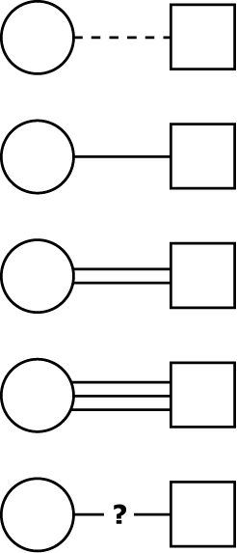
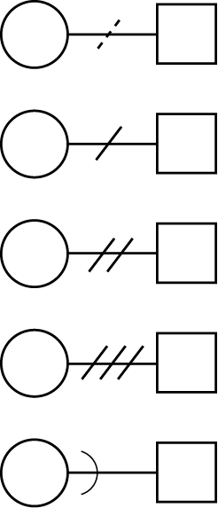
Family Mapping Legend (2 of 4)
Relationships are indicated by different lines between members:
Minimal connection
Unacknowledged conflict
Typical connection
Mild conflict
Stronger
than most connections
Moderate conflict
Enmeshed (unclear boundaries)
Heavy conflict
Nature of relationship
is uncertain
Family member
who is cut off through divorce, abandonment, prison

Slide 55

Family Mapping Legend (3 of 4)
Generational and group boundaries
are indicated in the following manner:
Generational line between parents and children
Flexible
group boundary

Slide 56

Family Mapping Legend (4 of 4)
Generational and group boundaries
are indicated in the following manner:
Rigid
controlling
group
boundary
Unclear, unprotected group
boundary

Slide 57

Four Examples of Family Maps* (1 of 4)
Family Map: Example A
M
F
14
11
* Adapted from Edwards, John T. Child Welfare and Substance Abuse Interventions. Atlanta, Georgia: Child Welfare Institute, 1993.

Slide 58

Four Examples of Family Maps (2 of 4)
Family Map: Example B
F
M
13
8

Slide 59

Four Examples of Family Maps (3 of 4)
Family Map: Example C
M
F
F
7
14
11

Slide 60
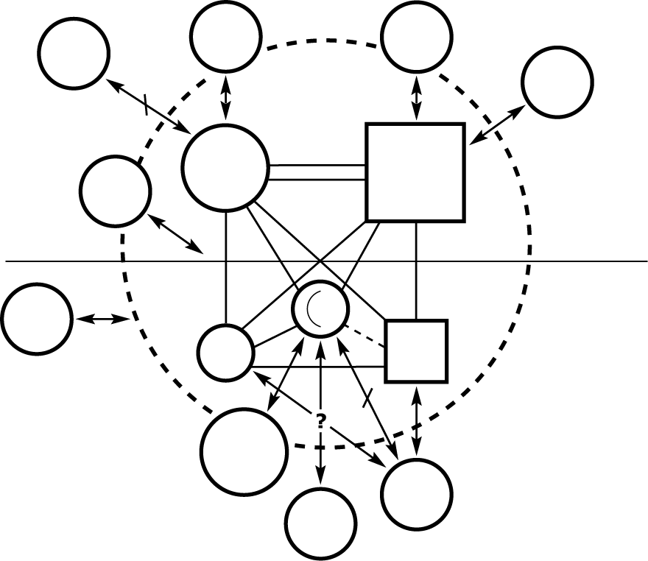
Four Examples of Family Maps (4 of 4)
Family Map: Example D
Best
Friend
Best
Friend
Work
Work
M
F
Relatives
Church
(Temple)
7
14
11
Caseworker
School
Birth
Family

Slide 61
Five Elements of An Explanation (1 of 2)
1. What the child and family tell about the reason for placement.
2. Is not a lie.
3. Generalized and leaves
out details.

Slide 62
Five Elements of An Explanation (2 of 2)
4. Minimized and leaves
out trauma.
5. Universalized and sounds like a situation many children could be in without feeling shame.

Slide 63
Meeting 8
Responding to Disclosures
of Prior Sexual Abuse
© 2014 New York State Office of Children and Family Services.

Slide 64
Why Does a Child
Who Has Been Sexually
Abused Keep Secrets?

Slide 65
Cycle of Need
Need
Relaxation
Expression
(Behavior)
Need is Met

Slide 66
Cycle of Unmet Need
Need
Anxious
Angry
Fearful
MISTRUST
Expression
(Cry)
Need is
Not Met

Slide 67
Behaviors Resulting From Trust and Attachment:

Slide 68
Disclosure
Delayed
Conflicted
Unconvincing

Slide 69
Child Behaviors That
May Be An Opportunity for Disclosure:

Slide 70
Reactions of
Unprepared Parents
to Behaviors:

Slide 71
Needs of a Child Struggling with a
Painful Secret:

Slide 72
“I think you must have
been hurt, and it wasn’t your fault. I want to understand
what happened, so I can help
you feel safe. Will you tell
me what happened?”

Slide 73
What Effective Communicators Do
in Very Sensitive Discussions:

Slide 74
Closed Questions
Ask for One-Word Answers:
“Did someone touch
your tu-tu?”

Slide 75
Open Questions
Ask for Explanation:
“What happened
next?”

Slide 76
Meeting 9
Preventing Further
Sexual Abuse
© 2014 New York State Office of Children and Family Services.

Slide 77
Open Discussion of Sex
Almost Never
Indirectly
Uncomfortably
Comfortably

Slide 78
Four Conditions for Sexual Abuse
1. MOTIVATION
2. Overcoming Personal
Rules
3. OPPORTUNITY
4. Overcoming the Child’s Resistance

Slide 79
Ways to Reduce Opportunities for
Sexual Abuse:

Slide 80
Signals for Which Children Need
to Be Alert:

Slide 81
Giving Permission to Feel Emotion (1 of 2)
“You have gotten real
quiet. You seem scared.”

Slide 82
Giving Permission to Feel Emotion (2 of 2)
“I know that doesn't feel
good to you, most children
would feel scared. I care
about you, and I’ll help.”

Slide 83
Seven Steps in Talking With a Child
About Resisting Sexual Abuse
1. NORMALIZE
2. Define Physical Boundary
3. Validate Emotional Radar
4. EMPOWER
5. NO-GO-TELL
6. Who To Tell
7. Play “What if…”

Slide 84
Practice Activity
Parents (use Handout 4)
Child, age 6
Observers (use Handout 5, offer suggestions)
(10 Minutes)

Slide 85
Meeting 10
Handling False Allegations
of Sexual Abuse
© 2014 New York State Office of Children and Family Services.

Slide 86
What Are the Needs
of a Child Who Has
Been Sexually Abused?

Slide 87
Two Types of False Accusations
1. Naïve
2. Manipulative

Slide 88
Reasons for Naïve Accusations:

Slide 89
Small Group Activity
Each group examines (2)
items from Handout 2
Group 1: 1 & 2
Group 2: 3 & 4
Group 3: 5 & 6
Select Recorder/Reporter
(10 Minutes)

Slide 90
“You have a right
to say NO to a placement
request which does not
match the strengths your
family has to offer.”

Slide 91
Three-Step Model for Responding to Allegations Made Within the Family
1. Control Your Emotions
2. Talk With a Support
Person
3. Rehearse What You
Will Say to the Child

Slide 92
Four Ingredients in Discussing False Allegations with the Child
1. Identify the Child’s Emotions
2. Identify the Child’s Needs, Especially for Safety and Control
3. Support the Child for Telling
4. Clarify the Behavior as Nonsexual

Slide 93
What a Family Can Do During a Formal Investigation (1 of 2)
Talk with the caseworker before trying to engage the child in problem-solving.
Do not argue with the child
or with the agency.

Slide 94
What a Family Can Do During a Formal Investigation (2 of 2)
Know in advance your agency’s procedures when there is a formal allegation.
Keep communication open with the your support
people and groups.

Slide 95
Meeting 11
Teamwork With Mental Health, Legal and Social Service Providers for
the Child Who Has Been
Sexually Abused
© 2014 New York State Office of Children and Family Services.

Slide 96
Resource Persons
Needed in Teamwork:

Slide 97
Social Service
Providers’ Titles
and Roles:

Slide 98
Mental Health
Providers’ Titles
and Roles:

Slide 99
Legal Service
Providers’ Titles
and Roles:

Slide 100
Teamwork
Two or more people coming together in specified but flexible roles to work according to a coordinated plan and toward a common goal.

Slide 101
8 Steps of Social Contracting
1. Personal Acknowledgment
2. Communicate Your Understanding of the Situation
3. Get Other’s Wants and Offers
4. State Your Wants and Offers
5. Agreement
6. Feedback (Control and Vulnerability)
7. Give Support
8. Next Steps

Slide 102
Foster/Adoptive
Parents’ “Offers”

Slide 103
Foster/Adoptive
Parents’ “Wants”

Slide 104
Instructions for
Social Contracting Role Play
Roles: Mr. and Mrs. Harper; Therapist; Observer
Role play: 10 Minutes
Processing: 15 Minutes

Slide 105
Four Steps of the Legal Process in Child Sexual Abuse Prosecution
1. Investigative Interview
2. Hearing
3. Indictment
4. Trial
© 2014 New York State Office of Children and Family Services.

Slide 106
Instructions for Small Group Activity:
Preparing a Child for the Legal Process
List (1) or (2) things a foster/adoptive parent and other team members can do to help prepare a child for court.
Activity: 10 Minutes
Reporting: 10 Minutes (Each reporter taking 2 minutes)

Slide 107
Meeting 12
Partnership With Birth Families of Children Who Have Been Sexually Abused
© 2014 New York State Office of Children and Family Services.

Slide 108
Preparing for Visits: Needs, Wants and Offers
Birth Parents’ Needs
Joining with
Birth Parent
Child’s
Needs
1. Empathy
2. Empowering

Slide 109
Ways to Acknowledge the Needs of Birth Parents (1 of 5)
Communicate Empathy:
(By reflecting birth parents' emotions)
“You seem worried
about what your child
thinks of you.”

Slide 110
Ways to Acknowledge the Needs of Birth Parents (2 of 5)
Communicate Empathy:
(By helping birth parents say what
their needs are)
“What kind of
relationship do you and
your child need.”

Slide 111
Ways to Acknowledge the Needs of Birth Parents (3 of 5)
Exchange Wants and Offers:
“What I can offer
to help this visit be
successful is...”

Slide 112
Ways to Acknowledge the Needs of Birth Parents (4 of 5)
Exchange Wants and Offers:
“What I want from
you to help make this
successful is...”

Slide 113
Ways to Acknowledge the Needs of Birth Parents (5 of 5)
Exchange Wants and Offers:
“What do you
want, and what
can you offer...”

Slide 114
Your Emotions About Birth Parents Who Did Not Abuse nor Protect

Slide 115
Your Emotions
About Birth Parents
Who Did Abuse

Slide 116
Emotions of Birth Parents Who Did Not Abuse nor Protect

Slide 117
Emotions of Birth Parents Who Did Abuse

Slide 118
The Spectrum of Connections
Positively Framed Statements
Overnight
Visits

Slide 119
Fostering and Adopting the Child
Who Has Been Sexually Abused
Thank You!
© 2014 New York State Office of Children and Family Services.

